Slide 1
Lipids, Structure and Properties

Slide 2
Quiz Question 1
Which lipid is essential in the human diet
Cholesterol
Linoleate (18:2ω6)
Palmitate (16:0)
Oleate (18:1)
Notes:
B

Slide 3
Quiz Question 2
For polyunsaturated fatty acids how far along the chain are subsequent double bonds relative to the bond preceeding it
Double bonds are generally adjacent
Double bonds are generally two carbons farther along
Double bonds are generally three carbons farther along
Double bonds are generally four carbons farther along

Slide 4
Quiz Question 3
What does amphipathic mean?
A lipid has a hydrophilic and hydrophobic part
A fatty acid has multiple double bonds
Two different acyl chains are added to a glycerol head group
The lipid can sense what you are feeling right now

Slide 5
Learning Objectives
Understand the different roles of lipids in our bodies
Describe the structure and functions of triacylglycerols (triglycerides)
Recognize that phospholipids are amphipathic and play an important role as structural components within our body
Identify the structure and functions of cholesterol and other steroids
Use the common, n- and w nomenclature systems to describe fatty acids, and be able to draw fatty acids based on these various naming systems
Describe the structure of fatty acids and analyze how this affects their packing, solubility and physical state
Explain the roles of the essential fatty acids, including what makes them essential

Slide 6
Roles of lipids
Lipids have many functions in body
Structural and functional components of cells
Inflammatory response
Hormone production
Energy source
Insulation
Recommendations: 20-35% of energy intake per day (IOM Guidelines 2010)

Slide 7
Types of Lipids
Triglycerides
Phospholipids
Sterols

Slide 8
Structure of Sterols
Cholesterol
Fatty Acid Ester
(in this case oleic acid)
Cholesterol Ester

Slide 9
Role of cholesterol in cells
Component of cell membranes, enhances membrane fluidity
Pre-cursor to many bodily compounds
Bile salts
Hormones: estrogen, androgen, progesterone
Vitamin D
Not essential, can be made by cells

Slide 10
Phospholipids as amphipathic barriers
Notes:
Point out that this is phosphatidylcholine

Slide 11
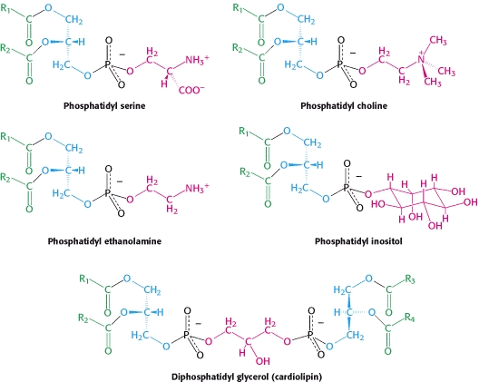
Structure of Phospholipids
Notes:
Head groups matter!

Slide 12
Choline Deficiency
A major phospholipid is phosphatidylcholine
Choline is a micronutrient used for methylation reactions
Humans can (barely) make it, so it is semi-essential, also important during pregnancy.
Deficiency can result in:
Developmental defects
NAFLD
Anxiety
Notes:
90% of people on earth are “choline deficient”
Classified as essential nutrient in 1998

Slide 13
Nutrigenomics and choline
Subjects were randomized into choline deficient diets
Monitored for signs of deficiency
Liver fat
Muscle breakdown
Variants in single-nucleotide polymorphisms of PEMT associated with responses to choline deficiency (OR: 25 in women)
28% of the population have this allele
da Costa K-A, Kozyreva OG, Song J, Galanko J A, Fischer LM, Zeisel SH. Common genetic polymorphisms affect the human requirement for the nutrient choline. FASEB J 2006; 20:1336–44.

Slide 14
At your table - Some thoughts on choline
Why do you think the deficiency might result in liver fat accumulation?
Do you think choline should be considered a vitamin

Slide 15
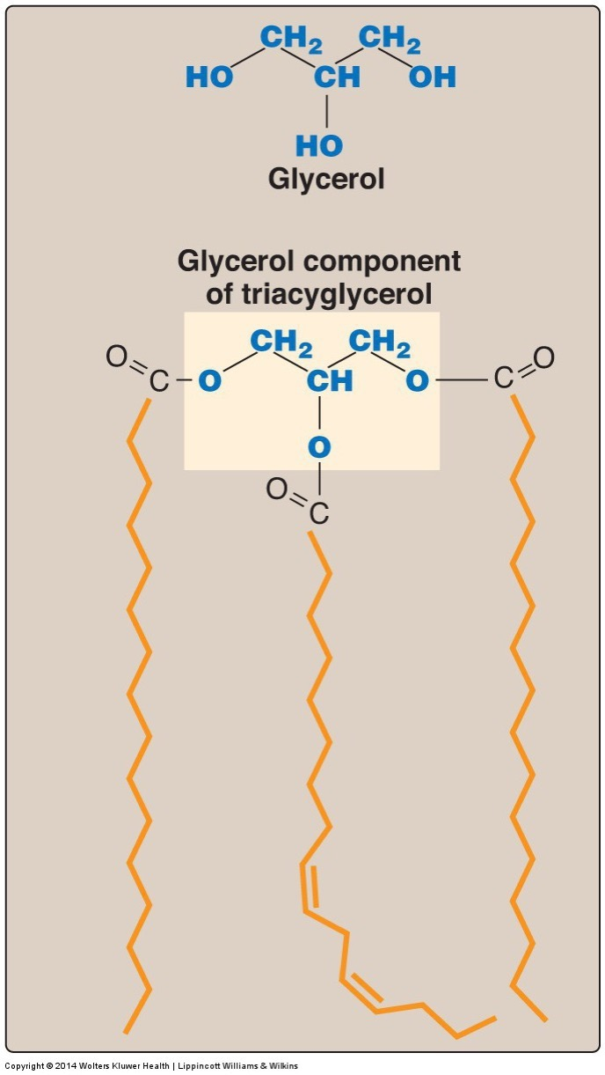
Structure of Triglycerides
95% of human fat
Largest energy store in the body
Glycerol backbone with three acyl groups
Stored with cholesterol in lipid droplets

Slide 16
Fatty Acid Nomenclature

Slide 17
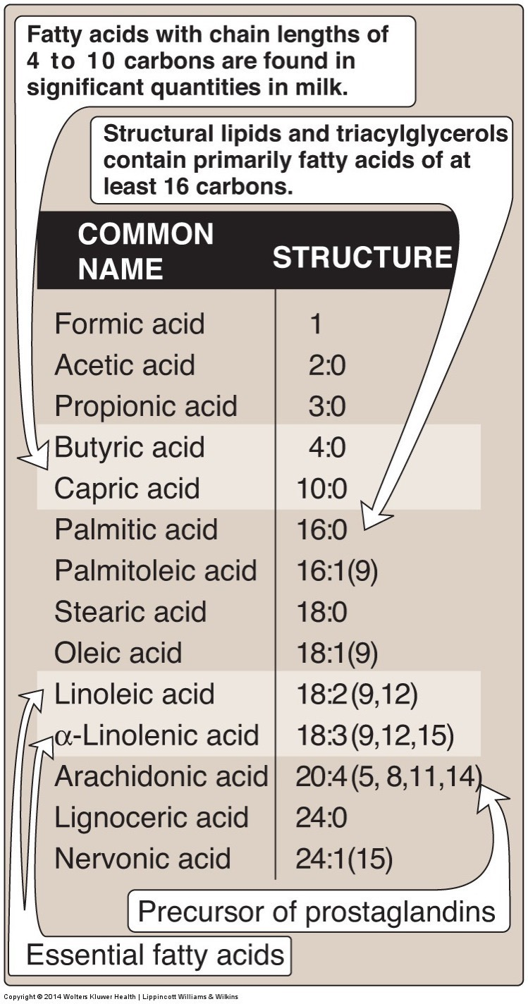
Fatty Acid Classification
Classification based on length
Short Chain < 6
Medium Chain 6-12
Long Chain 13-21
Very Long Chain 22+
Classification based on saturation (double bonds)
Saturated Fatty Acids
Monounsaturated Fatty Acids
Polyunsaturated Fatty Acids

Slide 18
Fatty Acid Structure/Function Notes
 | Effects
Shorter vs Longer | Longer has more energy Longer tends to be solid
Saturation vs desaturation | Desaturated less energy Desaturated more liquid Desaturated more prone to oxidation

Slide 19
Short Chain Fatty Acids are Derived in Gut
Derived from fiber
Will discuss this more next lecture

Slide 20
Medium Chain Fatty Acids
Shorter therefore more easily metabolized than long chain fatty acids
High in palm kernel and coconut oil
Generally saturated
Metabolized by intestinal cells and traffics straight to liver
Will discuss this in lecture on digestion

Slide 21
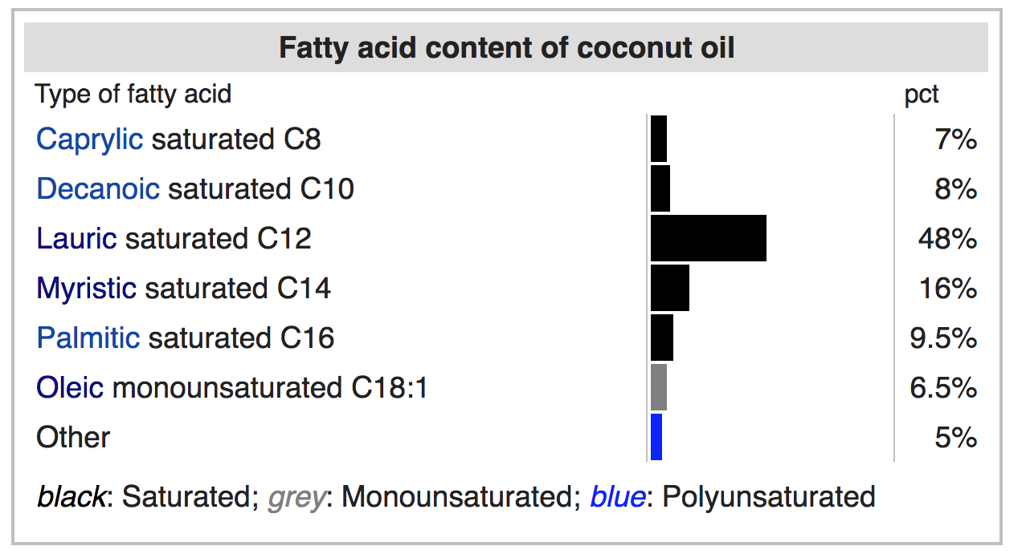
Composition of coconut oil
https://en.wikipedia.org/wiki/Coconut_oil

Slide 22
Saturated and Unsaturated Fatty Acids
Saturated Fatty Acids
Monounsaturated Fatty Acids (MUFA)
Polyunsaturated Fatty Acids (PUFA)

Slide 23
Effects of dietary fatty acid composition
Wang DD, Li Y, Chiuve SE, Stampfer MJ, Manson JE, Rimm EB, Willett WC, Hu FB. Association of Specific Dietary Fats With Total and Cause-Specific Mortality. JAMA Intern Med. 2016; 176: 1134–45. doi: 10.1001/jamainternmed.2016.2417.

Slide 24
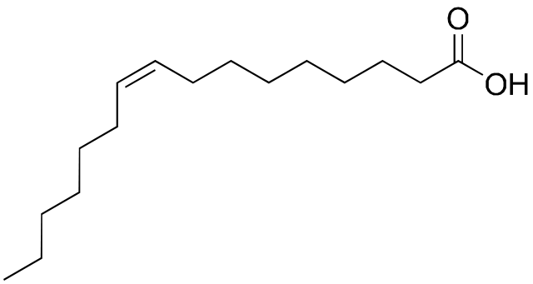
Nomenclature of Unsaturated Fatty Acids
Common name (Palmitate, Linoleate, etc)
Lipid numbers
N:D where:
N is the length of the chain
D is the number of double bonds
Ambiguous so often combined with Delta/ n-x or ω
Delta nomenclature
Δ indicates double bond location (from acid end)
n-x or ω nomenclature
Indicates double bond location (from methyl end)
Naming Type | Example
Common Name | Palmitoleic Acid
Delta | cis-Δ⁹-Hexadecenoic acid
n-x/ω | ω7 – Hexadecenoicacid
Lipid numbers | 16:1 or 16:1 ω7
9
7
5
3
7
1
8
6
4
2
6
5
4
3
2
1

Slide 25
Naming Practice – Draw These (all cis)
Myristic acid 18:0
Palmitoleic acid 16:1 cis-Δ⁹
Docosahexaenoic acid 22:6(n-3)
Multiple desaturations separated by one carbon with single bonds on either side (3 numbers)
Elaidic acid 18:1 trans-Δ⁹
Notes:
For multiple bonds, they start at omega end, and go back every third

Slide 26
Drawn Structures

Slide 27
Cis and Trans Fats
Most occurring fatty acids are cis
Trans fats are made industrially
Can make fats solid from easily available liquid fat (vegetable oils) via partial hydrogenation
Looks more like a saturated fat

Slide 28
Health Problems Associated with Trans Fatty Acids
Increases in risk factors for cardiovascular disease
Raised LDL, cholesterol, lowered HDL
Raised triglycerides
Increased inflammation and impaired endothelial cell function
Obesity
de Souza RJ, Mente A, Maroleanu A, Cozma AI, Ha V, Kishibe T, Uleryk E, Budylowski P, Schünemann H, Beyene J, et al. Intake of saturated and trans unsaturated fatty acids and risk of all cause mortality, cardiovascular disease, and type 2 diabetes: systematic review and meta-analysis of observational studies. BMJ 2015; 351:h3978.
Notes:
Mechanism currently unknown

Slide 29
Trans fat consumption

Slide 30
Replacing trans fats with palm oil
Grows in tropics, solid at Room Temperature
44% Palmitate 16:0
38% Oleate 18:1ω9
Why is palm but not olive oil solid at room temperature?
More saturated fats
Less saturated fats
Longer chain length
Shorter chain length
Compare with:
Butter
31% Palmitate 16:0
24% Oleate 18:1ω9
12% Myristate 14:0
11% Stearate 18:0
Olive oil
71% Oleate 18:1ω9
11% Palmitoleate 18:2ω7
11% Palmitate 16:0

Slide 31
Fatty Acids in Some Common Fats
Notes:
Point out the effects of hydrogenation of cottonseet oil

Slide 32
Fat and Oil Composition Assignment
Someone needs a laptop/tablet/iPhone
Go to https://ndb.nal.usda.gov/ndb/search/list
Under Select Source select Standard Reference
Type the oil you want to study
Click on Full Report (All Nutrients)
Fill in the details on each lipid in http://bit.ly/2mkxjlW
Are there high levels of any other micronutrients in this lipid?
Calculate % SFA, MUFA, PUFA, EFA for your lipid
Pick one fat (doesn't have to be yours) and submit a ~ 1 paragraph summary on the nature (solid/liquid) and ”quality” of the fat. Submit through GradeCraft by midnight Friday

Slide 33
Desaturases and Double Bond Formation
SCD1
NOT IN HUMANS

Slide 34
Studies on “Vitamin F”
Burr M, Miller S. Fatty Acids in Nutrition. J Biol Chem 1932; 97:1–9.

Slide 35
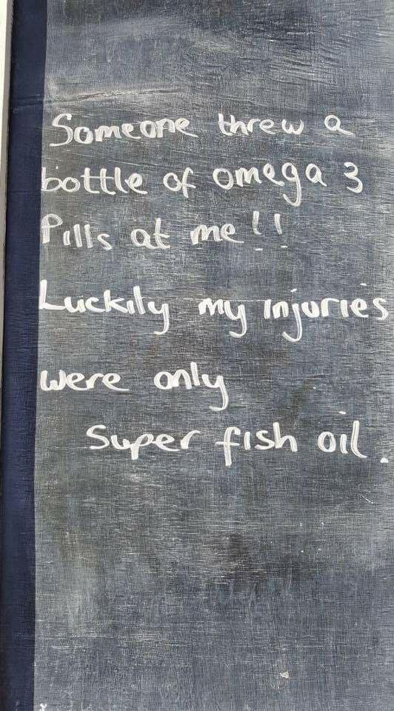

Slide 36
Fish Oil Supplementation
Cleo Moursi

Slide 37
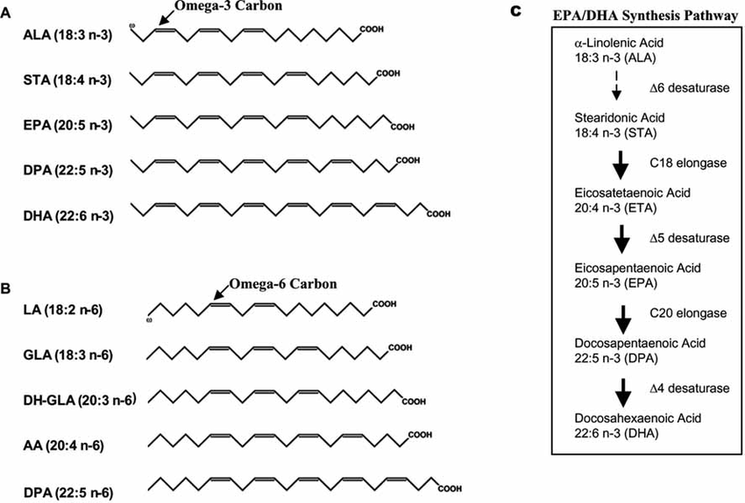
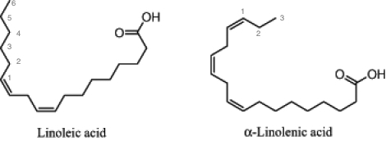
What are Omega-3s?
https://lpi.oregonstate.edu/mic/other-nutrients/essential-fatty-acids
Notes:
-fatty acids have more than one double bond in the backbone, so fewer than the maximum hydrogen atoms bound.
-Double bond at 3 and 6 position are most biologically significant
-final carbon in FA chain is “omega” carbon, so omega 3 is when the 3rd to last carbon has the double bond
-ratio is important. the recommended is 4:1, western diet = 8:1 – 25:1 omega 6 to omega 3 ratio
-both metabolized by same elongation and desaturation enzymes, so overabundance of one limits the production of metabolic products from the other
-ALA is from plant sources like seeds, walnuts and vegetables, and can be converted to EPA and somewhat to DHA, but only in small amounts (women convert better, because estrogen supports conversion enzymes)
-Still necessary to consume EPA and DHA in order to increase levels of these
-omega 3 acts as antiatherogenic agent (prevents fat build up in the arteries), lowers BP, help clean up after an inflammatory response (resolving), inhibits platelet aggregation (on the other hand, omega 6s are inflammatory via leukotrienes and prostaglandins)
https://www-ncbi-nlm-nih-gov.proxy.lib.umich.edu/pmc/articles/PMC2719153/
So it makes sense that people are excited about the possibility of omega 3 supplements improving health, specifally cardiac
Picture: https://lpi.oregonstate.edu/mic/other-nutrients/essential-fatty-acids

Slide 38
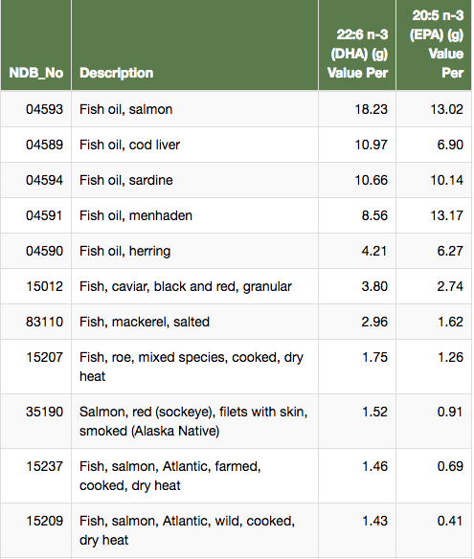
Getting Omega-3s
Fish oil (EPA/DHA)
ALA
Whole fish
https://ndb.nal.usda.gov/ndb/nutrients/report/nutrientsfrm?max=25&offset=0&totCount=0&nutrient1=621&nutrient2=629&nutrient3=&subset=0&sort=c&measureby=g
Notes:
Supplements are very popular
-study analyzed 47 commericial fish, krill and algal oil supplements, over 70% did not contain the stated label amount of EPA or DHA
-But still complied with FDA regulations (see below)
https://www-ncbi-nlm-nih-gov.proxy.lib.umich.edu/pubmed/25044306
The Ocean Nutrition notification proposed the following exact words for “high” nutrientcontent claims for DHA and EPA combined:“ ‘Excellent source of Omega-3 EPA and DHA.’ (‘High in Omega-3 EPA andDHA;’ ‘Rich in Omega-3 EPA and DHA’). Contains _ mg of EPA and DHAcombined per serving, which is _ % of the 160 mg Daily Value for a combinationof EPA and DHA.”
https://www.fda.gov/downloads/Food/GuidanceRegulation/GuidanceDocumentsRegulatoryInformation/UCM484251.pdf
Scientist largely agree that increasing EPA and DHA levels in the blood is more important than lowering arachidonic or linoleic acid (from Omega 6s)
-Generally safe and with minimal side effects, mercury is far below upper safety limit
https://ods.od.nih.gov/factsheets/Omega3FattyAcids-HealthProfessional/
ALA is thought to help prevent heart disease as well as improve outcomes for diabetics
People who eat seafood 3-4 times a week are less likely to die of heart disease
https://nccih.nih.gov/health/omega3/introduction.htm
Pictures: http://beta.lekhafoods.com/speciality/seafood-recipes/side-dish/fish/japanese-steamed-whole-fish.aspx, https://www.reviews.com/fish-oil-supplement/

Slide 39
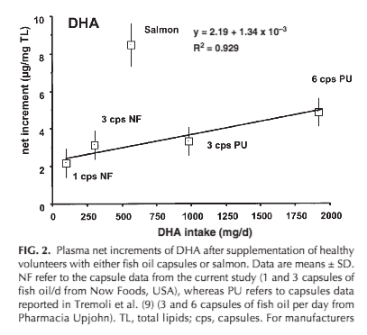
Fish vs. Fish oil
100g salmon or 1-3 fish oil capsules, esterified
Fatty acids form fish are more incorporated into plasma lipids
Potentially because ingested with more overall fat
Visioli, F., Risé, P., Barassi, M. C., Marangoni, F.,&Galli, C. (2003). Dietary intake of fish vs. formulations leads to higher plasma concentrations of n− 3 fatty acids. Lipids, 38(4), 415-418.
Notes:
https://onlinelibrary-wiley-com.proxy.lib.umich.edu/doi/epdf/10.1007/s11745-003-1077-x
From our data, it could be postulated that 10–20 g salmon would
effectively raise plasma DHA levels over a 6 week period
Volunteers given 100g salmon, 1-3 capsules of fish oil ethyl esters (used for high, prescription doses)

Slide 40

Impact
Little to no correlation between Omega-3 supplementation and decreased risk of heart disease
Fish eaters are less likely to experience heart attacks or angina than non-fish eaters
Potential role in treating depression
https://www.hivehealthmedia.com/two-foods-to-save-your-heart/
Notes:
Cochrane systematic review: results of seventy-nine randomized trials involving 112,059 people. These studies assessed effects of consuming additional omega 3 fat, compared to usual or lower omega 3, on diseases of the heart and circulation.
Found no correlation, ALA might reduce risk of heart irregularities but odds of this translating to reduced cardiac events was 1000 to 1
And slight protective affect against disease of circulation from ALA
It reduced triglycerides, which are known to promote heart disease, but also ”good cholesterol” (HDL) which is known to reduce heart disease
Studies make it difficult to determine the benefit: eating fish studies are mainly done on healthy adults, who they follow and see how many develop heart disease. Alternatively, omega 3 supplement studies are usually done on those who already have heart disease. It is possible that omega 3s may not reverse heart disease, or the the medication people are on may be the real cause of change
https://www.health.harvard.edu/heart-health/eating-fish-linked-to-fewer-heart-attacks via Nutrition Journal, March 15, 2013, 12:33.
*Cochrane study used healthy and unhealthy adults across four continents
According to a report in the September 2014 American Journal of Medicine that pooled results from 19 different studies, fish eaters were less likely to have a heart attack or unstable angina (unexpected chest pain that usually happens at rest) than non–fish eaters. Most of the studies were prospective, which means the participants reported what they ate and were tracked over time—in this case, for an average of 11 years.
-may be because fish replaces red/processed meat in the diet
Concerned about mercury and toxins? Meat also has toxins and the benefits of omega 3s overshadow this risk (to be safe, diversify and eat low contaminant choices like smaller fish, lower on the food chain)
Also ongoing study looking at Omega 3s and vitamin D supplementation in treating depression; via a reduction in inflammatory cytokines, which are linked to depression
https://www-sciencedirect-com.proxy.lib.umich.edu/science/article/pii/S1551714417306353#bb0255

Slide 41
Resources
Slide 2. Doughman, S. D., Krupanidhi, S.,&Sanjeevi, C. B. (2007). Omega-3 fatty acids for nutrition and medicine: considering microalgae oil as a vegetarian source of EPA and DHA. Current diabetes reviews, 3(3), 198-203.
Ander, B. P., Dupasquier, C. M., Prociuk, M. A.,&Pierce, G. N. (2003). Polyunsaturated fatty acids and their effects on cardiovascular disease. Experimental&Clinical Cardiology, 8(4), 164.
Slide 3. https://ndb.nal.usda.gov/ndb/nutrients/report/nutrientsfrm?max=25&offset=0&totCount=0&nutrient1=621&nutrient2=629&nutrient3=&subset=0&sort=c&measureby=g
Food Labeling: Nutrient Content Claims; Alpha-Linolenic Acid, Eicosapentaenoic Acid, and Docosahexaenoic Acid Omega-3 Fatty Acids; Guidance for Industry Small Entity Compliance Guide(pp. 3-8, Rep.). (2016). College Park, MD: Center for Food Safety and Applied Nutrition.
Slide 4. Visioli, F., Risé, P., Barassi, M. C., Marangoni, F.,&Galli, C. (2003). Dietary intake of fish vs. formulations leads to higher plasma concentrations of n− 3 fatty acids. Lipids, 38(4), 415-418.
Slide 5. Abdelhamid, A. S., Brown, T. J., Brainard, J. S., Biswas, P., Thorpe, G. C., Moore, H. J., ...&Song, F. (2018). Omega‐3 fatty acids for the primary and secondary prevention of cardiovascular disease. Cochrane Database of Systematic Reviews, (7).
Okereke, O. I., Reynolds III, C. F., Mischoulon, D., Chang, G., Cook, N. R., Copeland, T., ...&Manson, J. E. (2018). The VITamin D and OmegA-3 TriaL-Depression Endpoint Prevention (VITAL-DEP): Rationale and design of a large-scale ancillary study evaluating vitamin D and marine omega-3 fatty acid supplements for prevention of late-life depression. Contemporary clinical trials, 68, 133-145.
Oken, E., Guthrie, L. B., Bloomingdale, A., Platek, D. N., Price, S., Haines, J., ...&Wright, R. O. (2013). A pilot randomized controlled trial to promote healthful fish consumption during pregnancy: the Food for Thought Study. Nutrition journal, 12(1), 33.
Yinko, S. S. L., Stark, K. D., Thanassoulis, G.,&Pilote, L. (2014). Fish consumption and acute coronary syndrome: a meta-analysis. The American journal of medicine, 127(9), 848-857.

Slide 42
ω3 and ω6 Fatty Acids are Essential in Humans
We have desaturates, but not any ω3 and ω6 desaturases
Because of this, we cannot convert 18:0 into 18:2ω6 or 18:3ω3
These PUFAs are required for several signaling lipids and must be obtained from the diet.
From plant sources
Linoleic acid (18:2 ω-6) Alpha-linolenic acid (18:3 ω-3)
From fish oils
EPA and DHA
FADS2
FADS1
Notes:
Formerly called vitamin F

Slide 43
Efficiency of ALA -> DHA/EPA Conversion
Generally we consume about ! 1g/day of LA (18:3ω3)
We consume <0.2g/day of EPA/DHA
Sex differences
women convert more efficiently
Genetic Differences (FADS1/FADS2)
African Ancestry, lower conversion
Hispanic, higher conversion
Direct supplementation of EPA/DHA may be more effective
http://lpi.oregonstate.edu/mic/other-nutrients/essential-fatty-acids

Slide 44
PUFA’s and Inflammatory Responses
Hormones that are derived largely from Arachidonic Acid (20:4ω6)
Leukotrines
Produced in White Blood cells, promote inflammation
Thromboxanes also known as Eicosanoids
Blood clotting
Prostaglandins
Vasodilation
Inflammation

Slide 45
ω3 Fatty Acids are either Anti-inflammatory or Resolving

Slide 46
ω3 and ω6 Fatty Acid Ratio
ω3 are thought to be metabolically beneficial
ω6 are essential but are generally over-consumed relative to ω3
In western diets can be 15:1
They compete with each other for enzymes, which is thought to be why too much ω6 can cause ω3 pseudo-deficiency

Slide 47
Learning Objectives
Understand the different roles of lipids in our bodies
Describe the structure and functions of triacylglycerols (triglycerides)
Recognize that phospholipids are amphipathic and play an important role as structural components within our body
Identify the structure and functions of cholesterol and other steroids
Use the common, n- and w nomenclature systems to describe fatty acids, and be able to draw fatty acids based on these various naming systems
Describe the structure of fatty acids and analyze how this affects their packing, solubility and physical state
Explain the roles of the essential fatty acids, including what makes them essential

